Slide 1
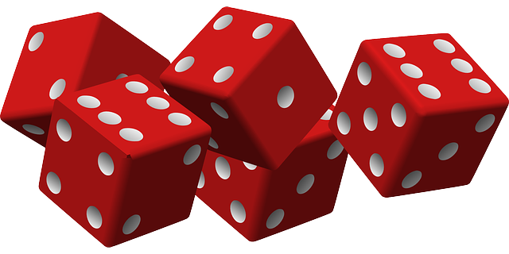

Slide 2
Rules
Teams of 3-4 people.
5 Dice per team. Each player takes a turn that consisits of 3 rolls.
Players must roll all of the dice on the first roll but then may choose only to roll selected dice for their last 2.
Once all three rolls have been taken you look at the dice to see where your score best fits in your score card.
Each space on the score card is a certain number of points. You must complete a jump for every point you receive. The only place where this does not apply is in the higher scoring boxes ( no “x” symbol) where you only need to complete one jump for each spot on the dice.
Add up your scores to see who the Jump Rope Yahtzee Winner! There may be a prize involved …

Slide 3
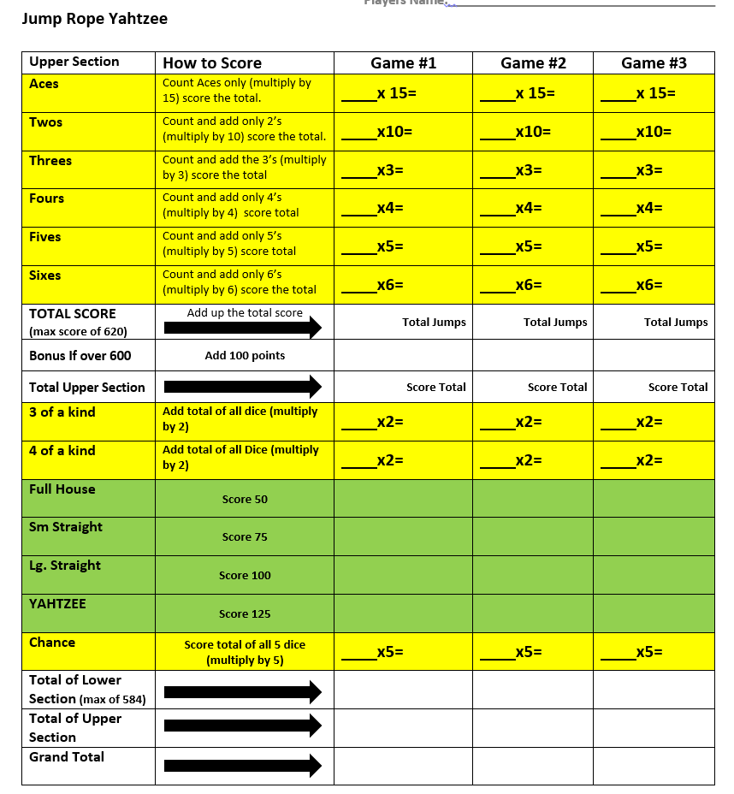
Yellow = 1 jump for every point after you multiply.
Green = 1 point for every spot on the dice.
White = Your totals and bonus points for high scores!

